Slide 1
Module 6: Lesson 1 Stream Ingestion and Processing Part 1

Slide 2
Batch Processing
To this point we have focused on big data processing technologies optimized to handle large volumes of data collected over an extended period of time
These technologies support batch processing where data, usually stored in files or objects, is not time-sensitive and can be processed at a later time
The purpose of these technologies is to generate insights periodically after data collection and not instantaneously
Batch processing technologies we have explored include the MapReduce batch processing engine, and aspects of Apache Spark supporting batch processing

Slide 3
Beyond Batch Processing Use Cases
To process payments and financial transactions in real-time, such as in stock exchanges, banks, and insurances.
To track and monitor cars, trucks, fleets, and shipments in real-time, such as in logistics and the automotive industry.
To continuously capture and analyze sensor data from IoT devices or other equipment, such as in factories and wind parks.
To collect and immediately react to customer interactions and orders, such as in retail, the hotel and travel industry, and mobile applications.
To monitor patients in hospital care and predict changes in condition to ensure timely treatment in emergencies.

Slide 4
Stream Processing
Stream processing involves the capture, storage, and analysis of data in real-time from sources like databases, sensors, mobile devices
Examples include live sensor data, social media updates, financial transactions, or any data that is generated and transmitted continuously without distinct start or end points
Unlike batch processing, which operates on static datasets, stream processing involves the immediate evaluation of data as it arrives, providing insights and results in near real-time.
Big data streaming systems provide the infrastructure needed to accept and process data flows having high velocity and/or high volume

Slide 5
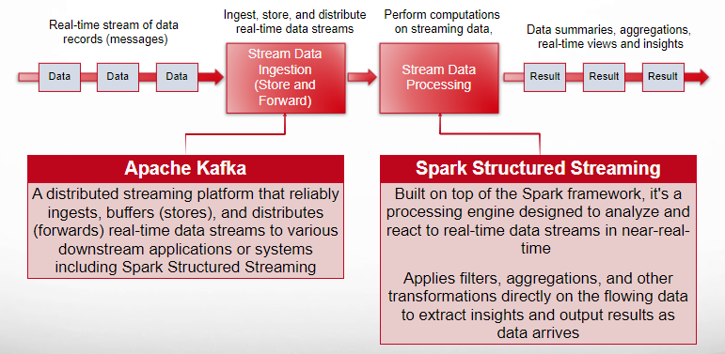
Two Aspects of Stream Processing Ingestion (Store and Forward) and Processing

Slide 6
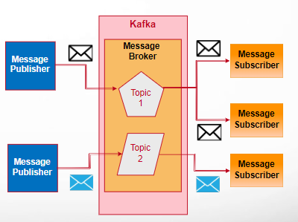
Apache Kafka Publish and Subscribe Messaging System Concept
Producers (publishers) of messages are decoupled from consumers (subscribers)
Producers send messages to a topic or channel without knowing specific recipients
Consumers express interest in topics and receive messages matching their subscriptions
This model enables flexible communication without tight synchronization constraints
A message broker acts as a central hub, managing message distribution and delivery

Slide 7
Apache Kafka Working Definition
Kafka is a publish and subscribe messaging system developed at LinkedIn
It operates as a cluster of servers (called brokers) providing high scalability and fault tolerance
It stores messages durably on disk and replicates them within the cluster to prevent data loss
Kafka is designed to handle high-volume and high-velocity data streams with minimal delay

Slide 8
Apache Kafka Working Definition
Kafka can be used as a solution to handling the ingestion and distribution of high-volume and high-velocity data records and not just inter-application messages
In this case each Kafka “message” can be thought of as a data record made available by data sources in real time
Data consumers can process data at a rate they can handle
Unprocessed data is stored in Kafka, in a durable and fault-tolerant manner, until the consumer is ready to process it.
This data is retained for a long and configurable length of time and is not deleted after is is sent to consumers, but can be read again
Consumers can rebuild their state anytime by rereading and reprocessing the events in a topic
If a consumer goes down, it will simply pick up from where it left off when it comes back online again

Slide 9
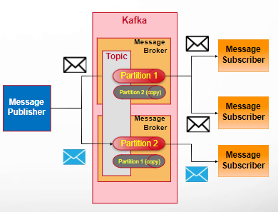
Apache Kafka Distributed Messaging and Stream Ingestion System
Kafka is designed as a distributed publish-subscribe messaging system
Follows a decentralized architecture where topic data is partitioned and distributed across multiple brokers
This decentralization enhances fault tolerance and ensures efficient data processing and retrieval
Engineered for high throughput and scalability, making it suitable for handling real-time (high velocity) data streams and massive amounts of messages
Ensures durability by persisting messages on disk and replicating data (partitions) across multiple brokers

Slide 10
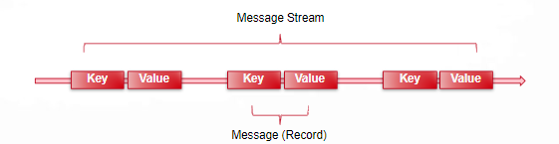
Apache Kafka Message Concept
The unit of data within Kafka is called a message composed of a value and an (optional) key
If you are approaching Kafka from a database background, you can think of this as similar to a row or a record
A message value is simply an array of bytes, as far as Kafka is concerned, so the data contained within it does not have a specific format or meaning to Kafka
Messages can have an optional bit of metadata which is referred to as a key
The key is also a byte array, and as with the value, has no specific meaning to Kafka
The purpose of a Kafka message key is to help producers send messages to specific partitions within a topic

Slide 11

Apache Kafka Publish and Subscribe Messaging System Concept
One example of this model is Twitter (now know as X)
A publisher (user) established an account (a topic)
Multiple subscribers (other users) then indicate interest in (subscribe) receiving tweets from that account
The publisher then enters (publish) one or more tweets (messages)
Each tweet (message) is then made available to every subscriber of that account (topic)

Slide 12
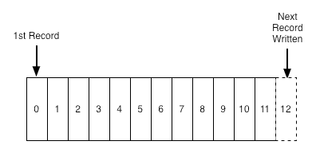
Apache Kafka Commit Log Concept
A log is perhaps the simplest possible storage abstraction
It is an append-only (and otherwise immutable) totally-ordered sequence of records ordered by time
Records are appended to the end of the log, and reads proceed left-to-right
Each entry is assigned a unique sequential log entry number
The ordering of records defines a notion of "time" since entries to the left are defined to be older then entries to the right
The log entry number can be thought of as the "timestamp" of the entry.

Slide 13
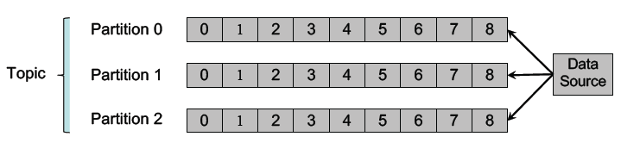
Apache Kafka Topic and Partition Concepts
Messages are organized into topics (message groupings), and each topic is split into partitions
Each partition is an immutable, time-sequenced log of messages on disk
Note that time ordering is guaranteed within, but not across, partitions

Slide 14
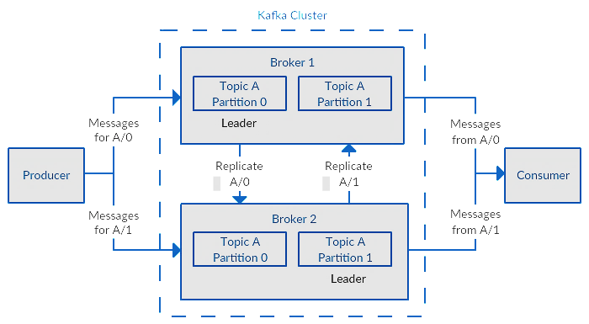
Apache Kafka Topic and Partition Concepts
The partitions of each topic are distributed over brokers in the Kafka cluster…
With each broker handling data and requests for a share of the partitions
Each partition is replicated across a configurable number of brokers for fault tolerance
Kafka may use the message key to automatically group similar messages into a partition
This scheme enables Kafka to dynamically scale the messaging infrastructure
Topic with 2 partitions and a replication factor of 2

Slide 15
Apache Kafka Topic and Partition Concepts
The partitions in the topic serve several purposes…
First, they allow the topics to scale beyond a size that will fit on a single server
Each individual partition must fit on the server that hosts it
But a topic may have many partitions (distributed across multiple servers)
This allows a topic to handle an arbitrary amount of data
Second, distributed partitions act as the unit of parallelism

Slide 16
Apache Kafka Topic and Partition Concepts
Kafka replicates each topic’s partitions across a configurable number (n) of servers
This enables automatic failover to one of these replicas when up to n – 1 servers fail
Each partition in Kafka has a single leader replica and zero or more follower replicas
Reads and writes go to the leader replica with other replicas updated asynchronously
If the leader replica fails, another replica becomes the leader

